Slide 1
MODULE II

Slide 2
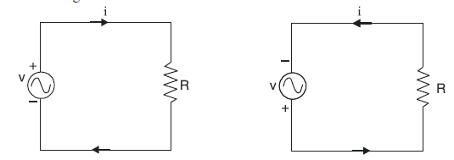
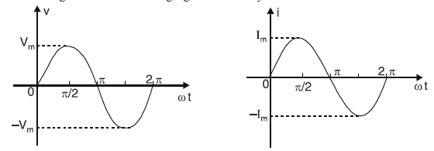
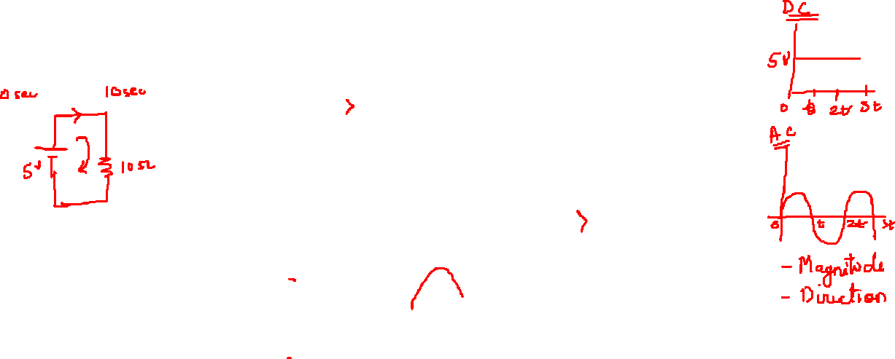
A.C. FUNDAMENTALS
Advantages
Alternating voltages can be stepped up or stepped down efficiently by means of a transformer.
A.c. motors (induction motors) are cheaper and simpler in construction than d.c. motors.
The switchgear (e.g. switches, circuit breakers etc.) for a.c. system is simpler than the d.c. system

Slide 3
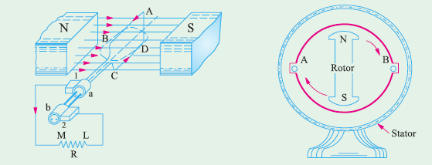
Generation of Alternating Voltages and Currents
An alternating voltage may be generated :
(i) by rotating a coil at constant angular velocity in a uniform magnetic field
or
(ii) by rotating a magnetic field at a constant angular velocity within a stationary coil
The value of the voltage generated depends, in each case, upon the number of turns in the coil, strength of the field and the speed at which the coil or magnetic field rotates. The first method is used for small a.c. generators while the second method is employed for large a.c. generators

Slide 4
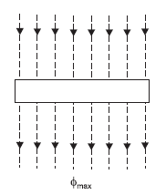


Equation of Alternating Voltage and Current
Consider a rectangular coil of n turns rotating in anticlockwise direction with an angular velocity
of ω rad/sec in a uniform magnetic field as shown in Fig
Let the time be measured from the instant the plane of the coil coincides with OX-axis. In this position of the coil, the flux linking with the coil has its maximum value φmax.
Let the coil turn through an angle θ (= ωt) in anticlockwise direction in t seconds. In this position, the maximum flux φmax acting vertically downward can be resolved into two perpendicular components viz.
Flux linkages of the coil
= No. of turns × Flux linking = n Φmax coswt
According to Faraday’s laws of electromagnetic induction, the e.m.f. induced in a coil is equal to the rate of change of flux linkages of the coil

Slide 5


The value of v will be maximum (call it Vm) when sin ωt = 1 i.e., when the coil has turned through 90º in anticlockwise direction from the reference axis.
Thus a coil rotating with a constant angular velocity in a uniform magnetic field produces a sinusoidal alternating e.m.f. If this alternating voltage (v = Vm sin ωt) is applied across a load, alternating current flows through the circuit which would also vary sinusoidally i.e., following a sine law. The equation of the alternating current is given by ;

Slide 6
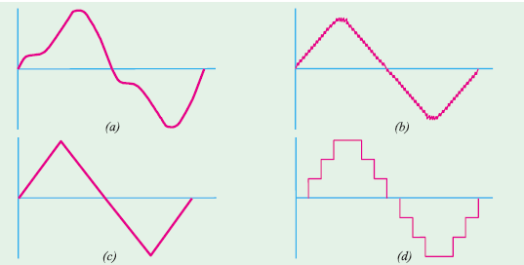
Simple Waveforms

Slide 7
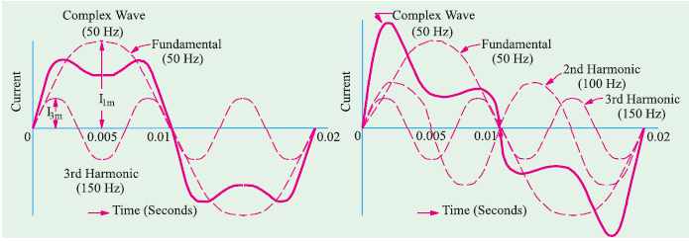
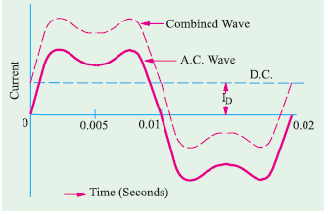
Complex Waveforms

Slide 8
Important A.C. Terminology
An alternating voltage or current changes continuously in magnitude and alternates in direction
at regular intervals of time. It rises from zero to maximum positive value, falls to zero, increases to
a maximum in the reverse direction and falls back to zero again
Waveform. The shape of the curve obtained by plotting the instantaneous values of voltage or current as ordinate against time as abcissa is called its waveform or waveshape.
Instantaneous value. The value of an alternating quantity at any instant is called instantaneous value.
Cycle. One complete set of positive and negative values of an alternating quantity is known as a cycle. A cycle can also be defined in terms of angular measure. One cycle corresponds to 360º electrical or 2π radians.
Alternation. One-half cycle of an alternating quantity is called an alternation. An alternation spans 180º electrical. The positive or negative half of alternating voltage is the alternation.
Time period. The time taken in seconds to complete one cycle of an alternating quantity is
called its time period. It is generally represented by T.
Frequency. The number of cycles that occur in one second is called the frequency (f) of the
alternating quantity. It is measured in cycles/sec (C/s) or Hertz (Hz). One Hertz is equal to 1C/s.
Amplitude. The maximum value (positive or negative) attained by an alternating quantity
is called its amplitude or peak value. The amplitude of an alternating voltage or current is designated
by Vm (or Em) or Im.

Slide 9


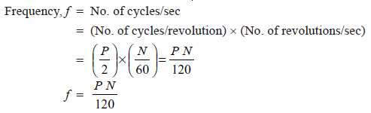
Time period and frequency.
Time taken to complete f cycles = 1 second
Time taken to complete 1 cycle = 1/f second
Angular velocity and frequency
the coil is rotating with an angular velocity of ω rad/sec in a uniform magnetic field. In one revolution of the coil, the angle turned is 2π radians and the voltage wave completes 1 cycle. The time taken to complete one cycle
is the time period T of the alternating voltage.
Frequency and speed
A coil rotating at a speed of N r.p.m. in the field of P poles. As the coil moves past successive north and south poles, one complete cycle is generated. Obviously, in one revolution of the coil, P/2 cycles will be generated

Slide 10


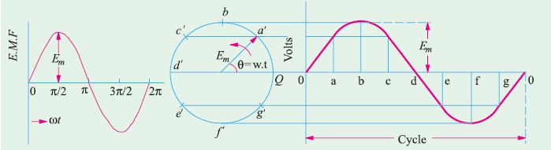
Different Forms of Alternating Voltage
Phase
Phase of a particular value of an alternating quantity is the fractional part of time period or cycle through which the quantity has advanced from the selected zero position of reference.

Slide 11
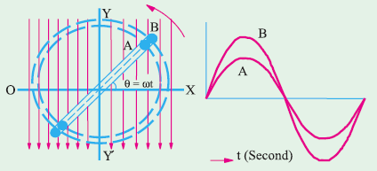

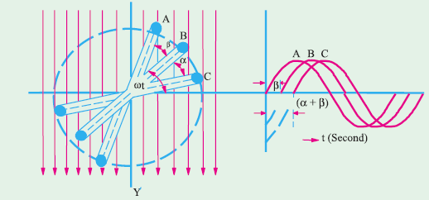
Phase Difference
when two alternating quantities of the same frequency have different zero points, they are said to have a phase difference.
B lags behind A by α and C lags behind A by (α + β) because they reach their maximum values later

Slide 12


‘lag’ or ‘lead’
A leading alternating quantity is one which reaches its maximum (or zero) value earlier as compared to the other quantity.
Similarly, a lagging alternating quantity is one which reaches its maximum or zero value later than the other quantity
B lags behind A by α and C lags behind A by (α + β) because they reach their maximum values later

Slide 13
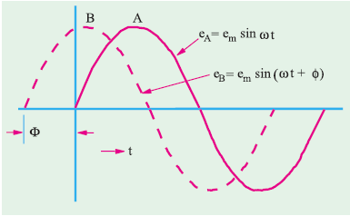


quantity B leads A by an angle Φ

Slide 14
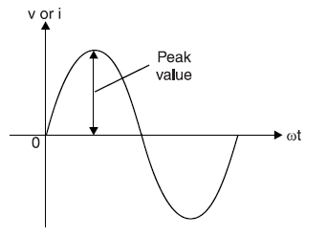

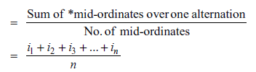
Peak Value
It is the maximum value attained by an alternating quantity. The peak or maximum value of an alternating voltage or current is represented by Vm
or Im.
Average Value
The average value of a waveform is the average of all its values over a period of time. That steady current which transfers across any circuit the same charge as is transferred by that alternating current during the same time.
In case of *symmetrical waves (e.g. sinusoidal voltage or current), the average value over one cycle is zero. It is because positive half is exactly equal to the negative half so that net area is zero. However, the average value of positive or negative half is not zero. Hence in case of symmetrical waves, average value means the average value of half-cycle or one alternation
In case of unsymmetrical waves (e.g. half-wave rectified voltage etc.), the average value is
taken over the full cycle.

Slide 15
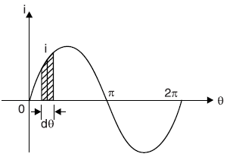
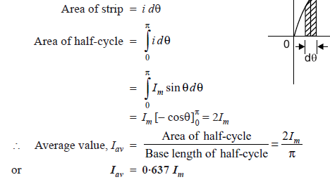
Average Value of Sinusoidal Current
Hence, the half-cycle average value of a.c. is 0·637 times the peak value of a.c.
For positive half-cycle, Iav = + 0·637 Im
For negative half-cycle, Iav = − 0·637 Im
Clearly, average value of a.c. over a complete cycle is zero. Similarly, it can be proved that for
alternating voltage varying sinusoidally, Vav = 0·637 Vm

Slide 16
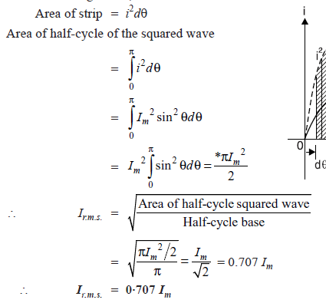
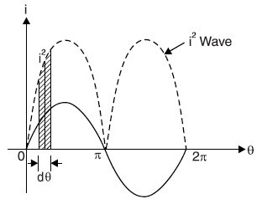

R.M.S.(Root Mean Square Value) or Effective Value
The effective or r.m.s. value of an alternating current is that steady current (d.c.) which when
flowing through a given resistance for a given time produces the same amount of heat as produced
by the alternating current when flowing through the same resistance for the same time.

Slide 17




Form Factor
The ratio of r.m.s. value to the average value of an alternating quantity is known as form factor i.e.
The form factor gives a measure of the “peakiness” of the waveform. The peakier the wave, the
greater is its form factor and vice-versa. For instance, a sine wave is peakier than a square wave. Similarly, a triangular wave is more peaky than a sine wave and has a form factor of 1·15.
Peak factor
The ratio of maximum value to the r.m.s. value of an alternating quantity is known as peak factor

Slide 18
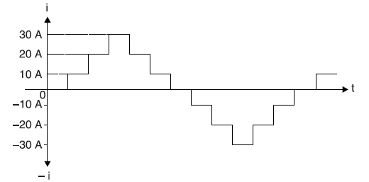
Q. An alternating voltage v = 200 sin 314t is applied to a device which offers an ohmic resistance of 20 Ω to the flow of current in one direction while entirely preventing the flow of current in the opposite direction. Calculate the current r.m.s. value, average value and form factor.
Q. A current has the following steady values in amperes for equal intervals of time changing instantaneously from one value to the next .0, 10, 20, 30, 20, 10, 0, −10, −20, −30, −20, −10, 0, etc. Calculate (i) average value (ii) r.m.s. value (iii) form factor and (iv) peak factor.

Slide 19
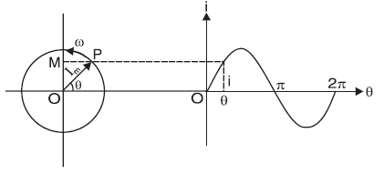
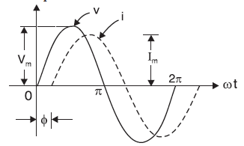


Phasor Representation of Sinusoidal Quantities

Slide 20
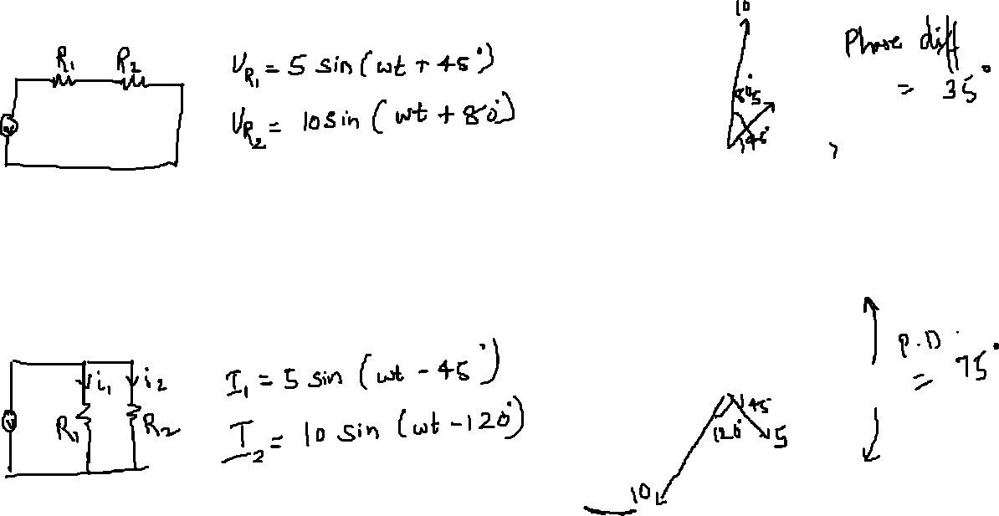
Representing Phasors

Slide 21


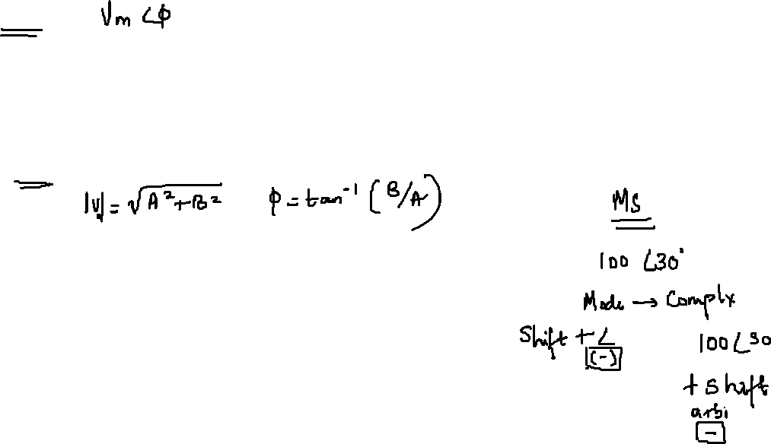
Representation
$$V_{m}$$
Polar Form
Φ
Rectangular Form
A + j B
Exponential Form
Vm $e^{−j∅}$

Slide 22
Three circuits in parallel take the following currents :
i1 = 20 sin 314 t ;
i2 = 30 sin (314 t − π/4) ;
i3 = 40 cos (314 t + 2π/3)
Find the expression for the resultant current.
its r.m.s. value and frequency

Slide 23
A circuit consists of four loads in series ; the voltage across these loads are given by the following relations measured in volts :
v1 = 50 sin ω t ;
v2 = 25 sin (ω t + 60º)
v3 = 40 cos ω t ;
v4 = 30 sin (ω t − 45º)
Calculate the supply voltage giving the relation in similar form.

Slide 24
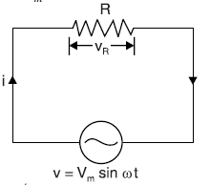



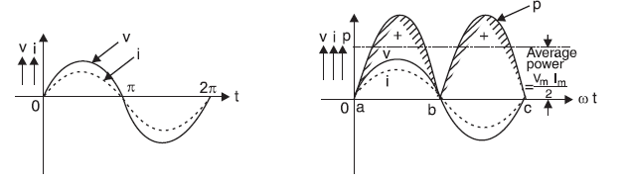
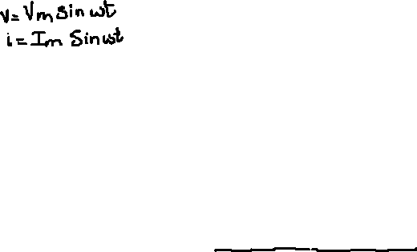
A.C. Circuit Containing Resistance Only
Let the alternating voltage be given by the equation
The value of i will be maximum (i.e. Im) when sin ωt = 1.

Slide 25

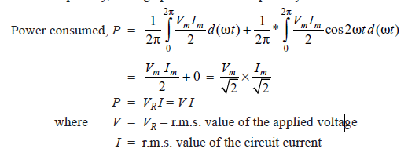
Power
Thus power consists of two parts viz. a constant part (VmIm/2) and a fluctuating part (VmIm/2) cos2ωt.
Since power is a scalar quantity, average power over a complete cycle is to be considered.

Slide 26
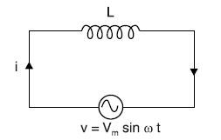
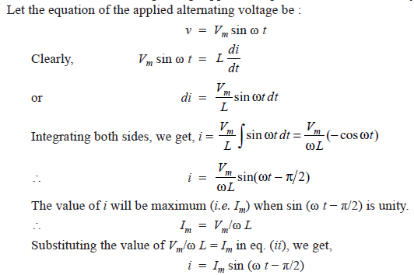
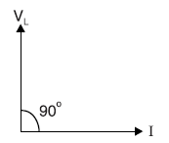
A.C. Circuit Containing Pure Inductance Only

Slide 27
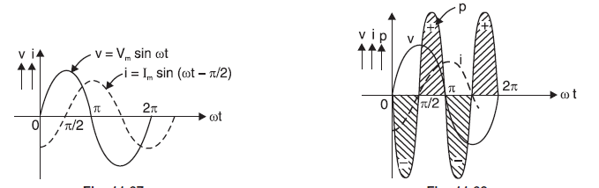

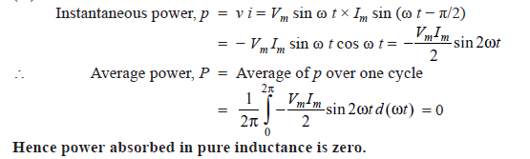

Inductive reactance
Power
In a resistance, current and p.d. are in phase and power is absorbed. In an inductance, current and p.d. are 90° out of phase and there is no net power consumed

Slide 28
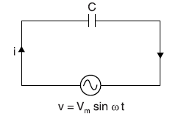
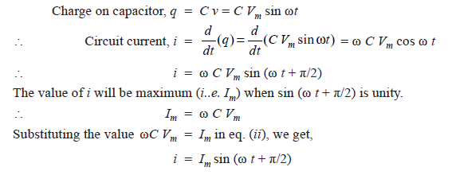
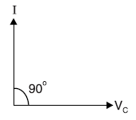
A.C. Circuit Containing Capacitance Only
Let at any instant i be the current and q be the charge on the plates.

Slide 29
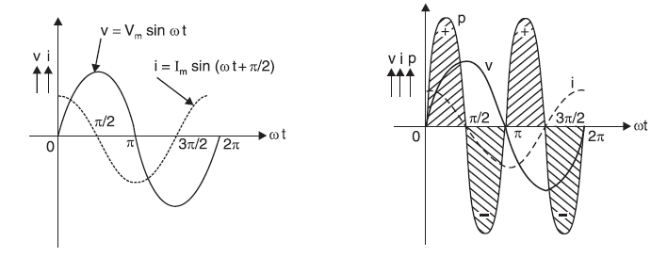


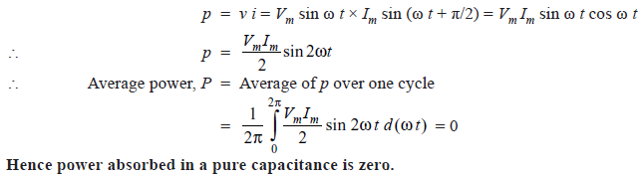

Capacitive reactance
Power

Slide 30
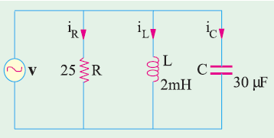
The voltage applied across 3-branched circuit of Fig. is given by v = 100 sin (5000t + π/4). Calculate the branch currents and total current.

Slide 31
The current in a circuit is given by (4.5 + j12) A when the applied voltage is (100 + j150) V. Determine (i) the magnitude of impedance and (ii) phase angle.

Slide 32
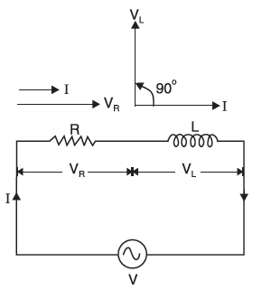
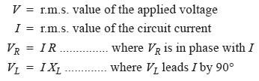
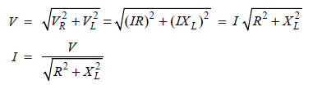
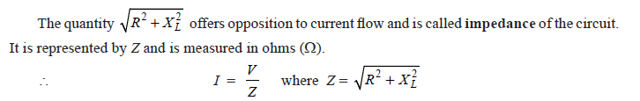
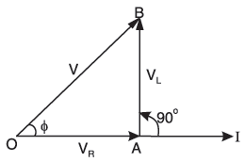
R- L Series A.C. Circuit
The applied voltage V is the phasor sum of

Slide 33

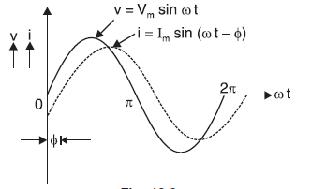

The value of phase angle Φ is
In an inductive circuit, current lags behind the applied voltage. The angle of lag (i.e. Φ) is greater than 0° but less than 90°. It is determined by the ratio of inductive reactance to resistance (tan Φ = XL/R) in the circuit. The greater the value of this ratio, the greater will be the phase angle Φ and vice-versa.

Slide 34
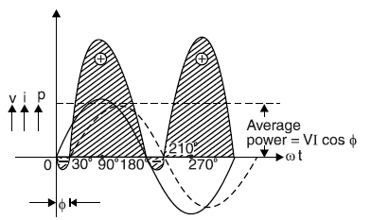
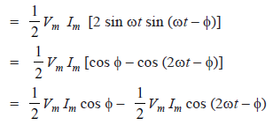


Power
The term cos Φ is called power factor of the circuit and its value is given by
This is expected because power is consumed in resistance only; inductance does not consume
any power.

Slide 35
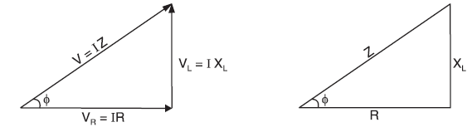
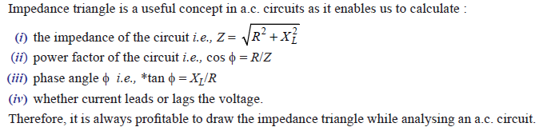
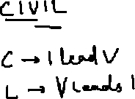
Impedance Triangle

Slide 36





Apparent power (S). The total power that appears to be transferred between the source and load is called apparent power. It is equal to the product of applied voltage (V) and circuit current (I) i.e.
Apparent power, S = V × I = VI = (P+jQ)
It is measured in volt-ampers (VA).
Apparent power has two components viz true power and reactive power.
True power (P). The power which is actually consumed in the circuit is called
true power or active power. The product of voltage (V) and component of total current in phase with voltage (I cos Φ) is equal to true power i.e.
It is measured in watts (W). The component I cos Φ is called in-phase component or wattful component because it is this component of total current which contributes to true power (i.e. VI cos Φ). It may be noted that it is the true power which is used for producing torque in motors and supply heat, light etc. It is used up in the circuit and cannot be recovered.

Slide 37


Reactive power (Q). The component of apparent power which is neither consumed nor does any useful work in the circuit is called reactive power. The power consumed (or true power) in L and C is zero because all the power received from the source in one quarter-cycle is returned to the source in the next quarter-cycle. This circulating power is called reactive power
The product of voltage (V) and component of total current 90° out of phase with voltage (I sin Φ) is equal to reactive power i.e.
It is measured in volt-amperes reactive (VAR). The component I sin Φ is called the reactive component (or wattless component) and contributes to reactive power (i.e. VI sin Φ). It does no useful work in the circuit and merely flows back and forth in both directions in the circuit. A wattmeter does not measure the reactive power.
Power triangle

Slide 38
A current of 10 A at a voltage of 200 V and its power factor is 0.8 lagging. Find Apparent power, true power and reactive power.
The reactive power does no useful work, it merely flows into and out of the circuit periodically. In fact, reactive power is a liability on the source because the source has to supply the additional current
(i.e. I sin Φ) to provide for this power

Slide 39
In an R-L series circuit, R = 10 Ω and XL = 8.66 Ω. If current in the circuit is (5 – j 10)A, find (i) the applied voltage (ii) power factor and (iii) active power and reactive power

Slide 40
In a given R–L series circuit, R = 35 Ω and L = 0.1 H. Find (i) current through the circuit (ii) power factor if a 50 Hz frequency, voltage V = 220 ∠ 30°V is applied across the circuit.

Slide 41

In the circuit, applied voltage V is given by (0 + j 10) V and the current is (0.8 + j 0.6) A. Determine the values of R and X also indicate if X is inductive or capacitive.

Slide 42

Power Factor
The power factor (i.e. cos Φ ) of a circuit can be defined in one of the following ways :
In a resistor, the current and voltage are in phase i.e. Φ = 0°. Therefore, power factor of a pure resistive circuit is
cos 0° = 1. Similarly, phase difference between voltage and current in a pure inductance or capacitance is 90°. Hence power factor of pure L or C is zero. This is the reason that power consumed by pure L or C is zero. For a circuit having R, L and C in varying proportions, the value of power factor will lie between 0 and 1.
power factor can never have a value greater than 1.
Power factor expressed as:
‘lagging’ or ‘leading’
Percentage-0.8 lagging power factor may be expressed as 80% lagging

Slide 43
Apparent Power → True power
→ reactive power
True power should be large → does useful work in the circuit
So reactive power should be small
Smaller the phase angle Φ → greater the power factor → smaller the reactive power component
Thus power factor of a circuit is a measure of its effectiveness in utilising the apparent power drawn by it. The greater the power factor of a circuit, the greater is its ability to utilise the apparent power

Slide 44

Q-factor of a Coil
The ratio of the inductive reactance (XL) of a coil to its resistance (R) at a given frequency is known as Q-factor of the coil at that frequency i.e.,
The Q-factor is used to describe the quality or effectiveness of a coil. A coil is usually designed
to have high value of L compared to its resistance R. The greater the value of Q-factor of a coil, the greater is its inductance (L) as compared to its resistance (R).

Slide 45




Power in an Iron-Cored Choking Coil
When an air-cored coil is connected to an a.c. supply, we have to supply power to meet the loss in the resistance R of the coil only. However, power P taken by an iron-cored coil has to supply :
The iron loss can be thought as additional resistance in series with the resistance of the coil. Thus the effect of iron core is to increase the effective resistance of the coil
Equating the two equations

